Slide 1
Chapter 5: CPU Scheduling

Slide 2
Outline
Basic Concepts
Scheduling Criteria
Scheduling Algorithms
Contention Scope in Thread Scheduling
Multiple-Processor Scheduling

Slide 3
Outline
Basic Concepts
CPU-I/O Burst Cycle
CPU Scheduler
Preemptive and Nonpreemptive Scheduling
Dispatcher
Scheduling Criteria
Scheduling Algorithms
Contention Scope in Thread Scheduling
Multiple-Processor Scheduling

Slide 4
應用程式的執行具備某些特性, 什麼特性呢?

Slide 5
CPU-I/O Burst Cycle
CPU–I/O Burst Cycle – process execution consists of a cycle of CPU execution and I/O wait
CPU burst, I/O burst, CPU burst, I/O burst……
I/O bound: many short CPU bursts, few long I/O bursts
Spend more time doing I/O than computations
CPU-bound: have a few long CPU burst
Spend more time doing computations

Slide 6
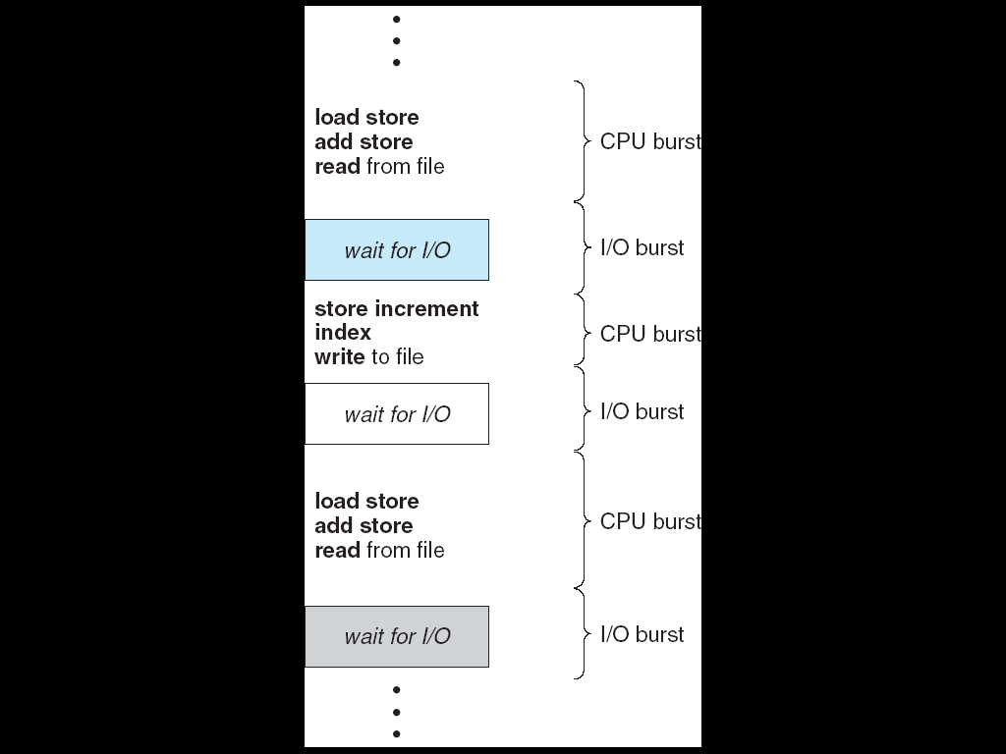
Alternating Sequence of CPU And I/O Bursts
…
a=a+1;
b=b-1;
c=cx5
fread()
x=x+1;
y=bx3;
fwrite()
b=ax1;
b=a-1;
c=dxa
fread()
…

Slide 7
如何利用這個特性提升效能呢?

Slide 8
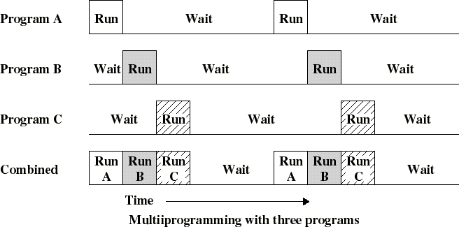
複習: Multi-Programmed Systems

Slide 9
Outline
Basic Concepts
CPU-I/O Burst Cycle
CPU Scheduler
Preemptive and Nonpreemptive Scheduling
Dispatcher
Scheduling Criteria
Scheduling Algorithms
Contention Scope in Thread Scheduling
Multiple-Processor Scheduling

Slide 10
Process Scheduling
Process scheduler (or CUP scheduler)
Selects from among the processes that are ready to execute, i.e., in the ready queue

Slide 11
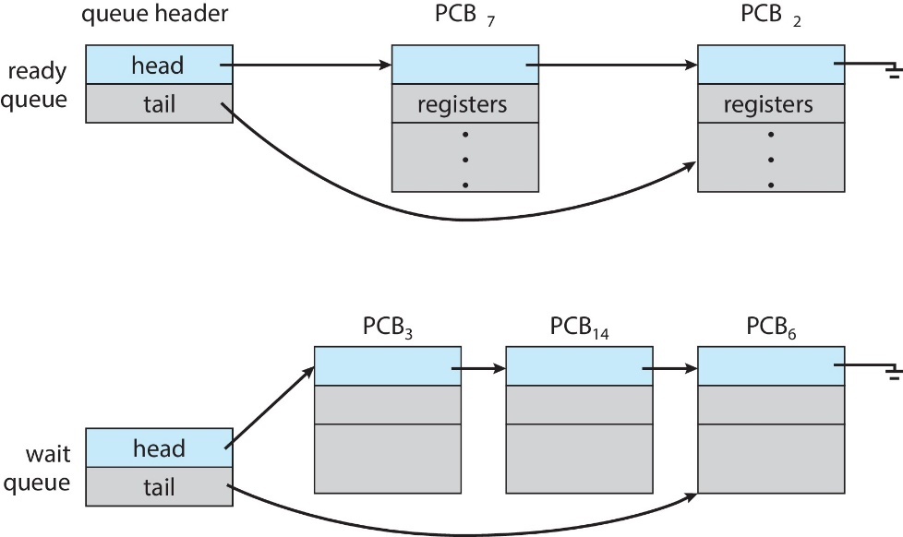
複習：The Ready Queue and Wait Queues

Slide 12
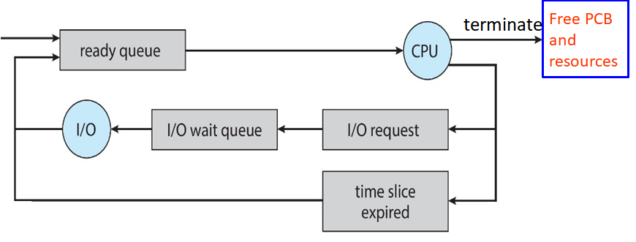
複習:第三章看到的圖 A Simple Queuing-Diagram Representation of Processes
CPU Scheduler
In real system, the diagram is much more complicated.

Slide 13
下一頁我們看新的較為複雜的圖

Slide 14
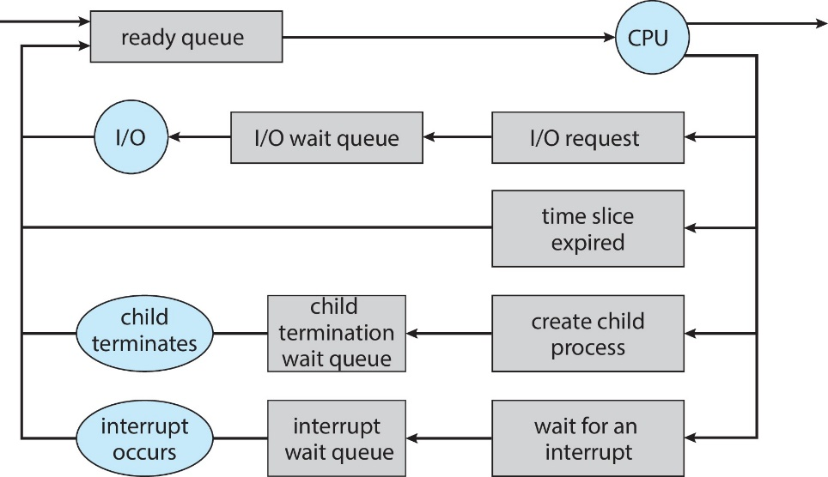
複習： Representation of Process Scheduling
CPU Scheduler
terminate
Free PCB
and
resources
In real system, the diagram is still much more complicated.

Slide 15
Outline
Basic Concepts
CPU-I/O Burst Cycle
CPU Scheduler
Preemptive and Nonpreemptive Scheduling
Dispatcher
Scheduling Criteria
Scheduling Algorithms
Contention Scope in Thread Scheduling
Multiple-Processor Scheduling

Slide 16
複習：在第一章和第三章我們提到 Example: CPU Scheduler is Invoked when a Timer Interrupt Occurs
…
for (;;) a=a+1;
…
CPU
…
add eax, ebx;
…
…..
interrupt
Timer
CPU Scheduler
OS
Interrupt Service
Routine (ISR)

Slide 17
In fact，CPU scheduler is not only invoked when timer interrupts occurs.

Slide 18
那CPU Scheduler何時會被執行呢?
Hint: see the following slide

Slide 19

複習：Diagram of Process State

Slide 20
Preemptive and Nonpreemptive Scheduling
CPU scheduling decisions may take place when a process:
1. Switches from running to waiting state
e.g. perform I/O or invoke wait()
2. Switches from running to ready state
e.g., when quantum expires
3. Switches from waiting to ready state
e.g., at completion of I/O
4. Terminates

Slide 21
觀察: 上述四個時間點的意義不同
Ans: 1 和 4是process自動放棄CPU
2和3 process被動放棄CPU

Slide 22
Nonpreemptive v.s Preemptive
Nonpreemptive or cooperative scheduling
When scheduling takes place only under 1 and 4
Process keeps the CPU until it releases the CPU
Bad for time-sharing system
Preemptive scheduling
Scheduling takes place under all the circumstances (1 to 4)
A process having obtained CPU may be forced to release CPU
A cost associated with shared data access
Addressed in Chapter 6

Slide 23
Outline
Basic Concepts
CPU-I/O Burst Cycle
CPU Scheduler
Preemptive and Nonpreemptive Scheduling
Dispatcher
Scheduling Criteria
Scheduling Algorithms
Contention Scope in Thread Scheduling
Multiple-Processor Scheduling

Slide 24
Dispatcher
Dispatcher: gives a CPU core to the process selected by the CPU scheduler
This involves: (see the following two slides)
Switching context from one process to another process
Switching to user mode
Jumping to the proper location to resume selected program
Dispatch latency – time it takes for the dispatcher to stop one process and start another running
Should be as fast as possible

Slide 25
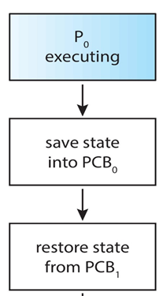
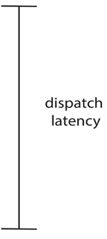
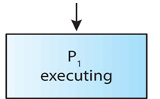
The Role of the Dispatcher
CPU changes from kernel mode to user mode
Jump to the selected process

Slide 26
Dispatch Latency
…
out eax, 0x60;
add eax, ebx;
…
CPU
eax | 59
ebx | 25
eax | 10
ebx | 5
…
out eax, 0x30;
add ebx, ebx;
…
…..
mode = 1;
mode = 0;
P1 PCB
eax=10; ebx=5;……
P1 PCB
eax=x; ebx=y;……
Scheduler
P2 PCB
eax=59; ebx=25;……
OS
Scheduler
選擇P2執行

Slide 27
Outline
Basic Concepts
Scheduling Criteria
Scheduling Algorithms
Contention Scope in Thread Scheduling
Multiple-Processor Scheduling

Slide 28
如何判斷一個CPU Scheduling Algorithm的好壞?
Hint: 要先決定衡量好壞的準則

Slide 29
Scheduling Criteria (準則)
Used to judge the performance of a scheduling algorithm
CPU utilization
Keep the CPU as busy as possible
Throughput
Number of processes that are completed per time unit
Turnaround time
Amount of time to execute a particular process
From process submission to process termination
Waiting time
Amount of time a process has been waiting in the ready queue
Response time
Amount of time it takes from when a request was submitted until the response is produced
For interactive processes, we may not care the turnaround time

Slide 30
Scheduling Criteria (Cont.)
Optimization Criteria -- may be conflict
Max CPU utilization
Max throughput
Min turnaround time
Min waiting time
Min response time

Slide 31
Outline
Basic Concepts
Scheduling Criteria
Scheduling Algorithms
Contention Scope in Thread Scheduling
Multiple-Processor Scheduling

Slide 32
接下來介紹一些CPU Scheduling Algorithm
你有自己的想法或是方法嗎?

Slide 33
Outline
Basic Concepts
Scheduling Criteria
Scheduling Algorithms
First-Come, First-Served Scheduling
Shortest-Job-First Scheduling
Round-Robin Scheduling
Priority Scheduling
Multilevel Queue Scheduling
Multilevel Feedback-Queue Scheduling
Contention Scope in Thread Scheduling
Multiple-Processor Scheduling

Slide 34
First-Come, First-Served (FCFS) Scheduling
Ready queue is a FIFO queue
Example:
Process CPU Burst Time
P₁ 24
P₂ 3
P₃ 3
Suppose that the processes arrive in the order: P₁ , P₂ , P₃
The Gantt Chart for the schedule is:
Waiting time for P₁ = 0; P₂ = 24; P₃ = 27
Average waiting time: (0 + 24 + 27)/3 = 17
P₁
P₂
P₃
0
24
27
30

Slide 35
First-Come, First-Served (FCFS) Scheduling (Cont.)
Suppose that processes arrive in the order: P₂ , P₃ , P₁
The Gantt chart for the schedule is:
Waiting time for P₁ = 6; P₂ = 0; P₃ = 3
Average waiting time: (6 + 0 + 3)/3 = 3
Much better than previous case
FCFS scheduling is nonpreemptive
Unsuitable for time-sharing systems
P₂
P₃
P₁
0
3
6
30

Slide 36
從前面兩個例子, 你有觀察到什麼現象嗎?
Ans: 我們喜歡CPU burst time短的process/thread先執行

Slide 37
那如果相反呢?
see the following slide

Slide 38
First-Come, First-Served (FCFS) Scheduling (Cont.)
Convoy effect (護衛效應):
Many short processes wait for the one big process to get off the CPU
Result in bad response time
Example: consider one CPU-bound and many I/O-bound processes
Q1: CPU-bound為什麼是big process?
Q2: I/O-bound為什麼是short process?

Slide 39
Outline
Basic Concepts
Scheduling Criteria
Scheduling Algorithms
First-Come, First-Served Scheduling
Shortest-Job-First Scheduling
Round-Robin Scheduling
Priority Scheduling
Multilevel Queue Scheduling
Multilevel Feedback-Queue Scheduling
Contention Scope in Thread Scheduling
Multiple-Processor Scheduling

Slide 40
如前述, 先執行CPU burst time短的process應該是最好的方法
這就是Shortest-Job-First (SJF) Scheduling的作法

Slide 41
Shortest-Job-First (SJF) Scheduling
The smallest next CPU burst length is selected
FCFS breaks a tie if the next CPU burst lengths are the same
Should be named as: shortest-next-CPU-burst first algorithm
Two schemes:
nonpreemptive –
preemptive – if a new process arrives with CPU burst length less than remaining time of current executing process, preempt the current process.

Slide 42
複習：Alternating Sequence of CPU And I/O Bursts
…
a=a+1;
b=b-1;
c=cx5
fread()
t
x=x+1;
y=bx3;
next CPU burst length
fwrite()
b=ax1;
b=a-1;
c=dxa
fread()
…

Slide 43
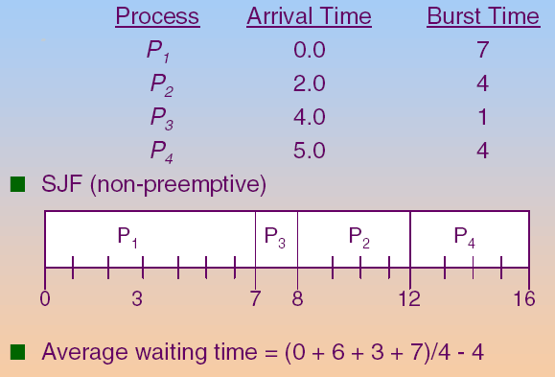
Example of Non-Preemptive SJF

Slide 44
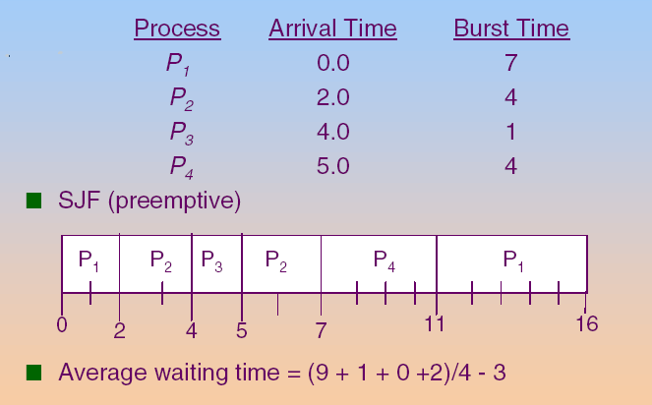
Example of Preemptive SJF

Slide 45
Shortest-Job-First (SJF) Scheduling (Cont.)
SJF is optimal – derives minimum average waiting time for a given set of processes
Q: 然而SJF很難實現, Why?
Not easy to know the length of the next CPU burst
怎麼辦呢?

Slide 46
Sol.: Predict(猜)
怎麼猜呢?

Slide 47
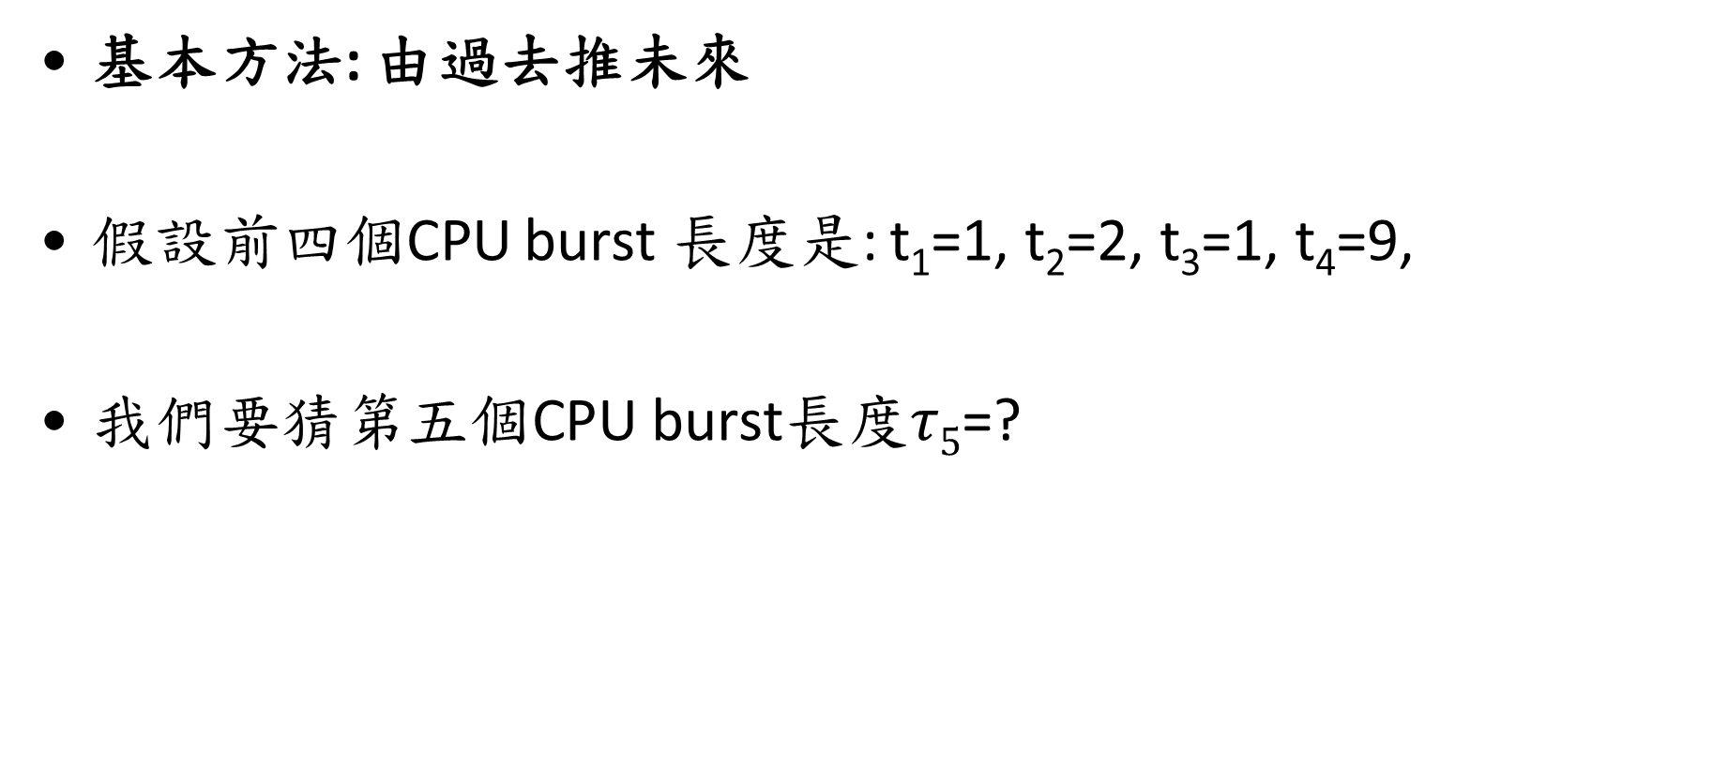
Predicting Length of Next CPU Burst
基本方法: 由過去推未來
假設前四個CPU burst 長度是: t₁=1, t₂=2, t₃=1, t₄=9,
我們要猜第五個CPU burst長度$τ5$=?

Slide 48
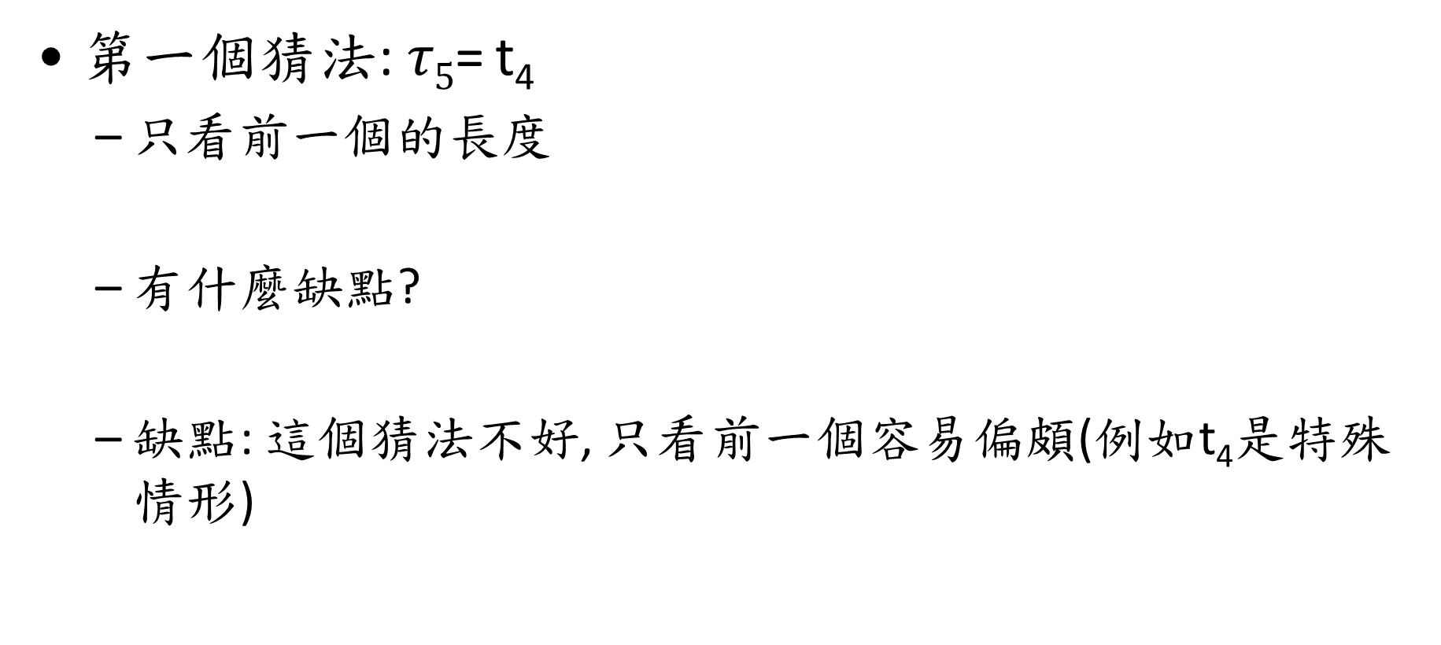
Predicting Length of Next CPU Burst
第一個猜法:$τ5$= t₄
只看前一個的長度
有什麼缺點?
缺點: 這個猜法不好, 只看前一個容易偏頗(例如t₄是特殊情形)

Slide 49
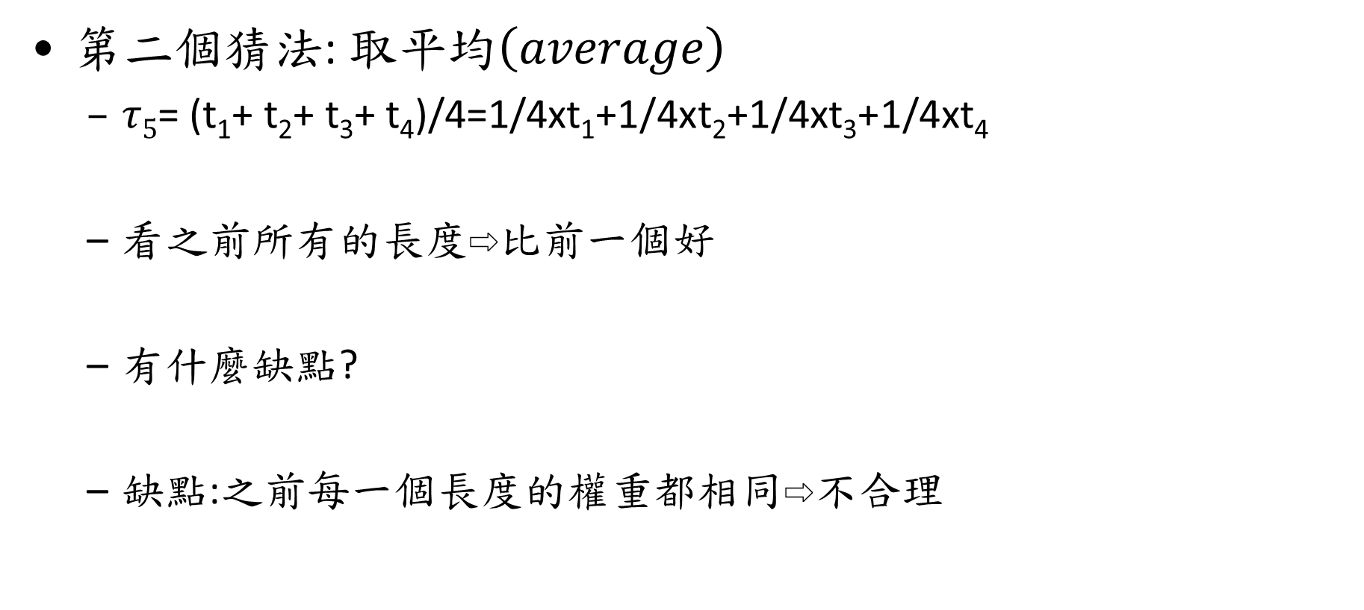
Predicting Length of Next CPU Burst
第二個猜法:$取平均\left(average\right)$
$τ5$= (t₁+ t₂+ t₃+ t₄)/4=1/4xt₁+1/4xt₂+1/4xt₃+1/4xt₄
看之前所有的長度⇨比前一個好
有什麼缺點?
缺點:之前每一個長度的權重都相同⇨不合理

Slide 50
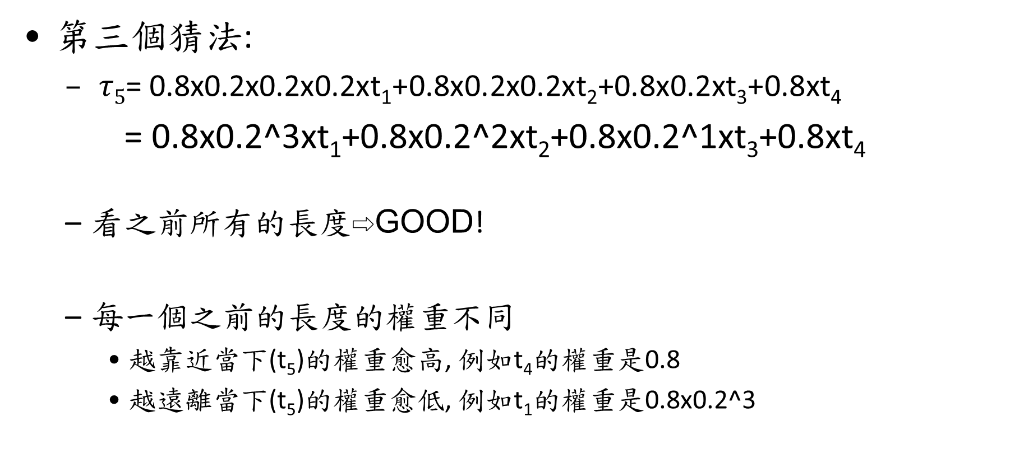
Predicting Length of Next CPU Burst
第三個猜法:
$τ5$= 0.8x0.2x0.2x0.2xt₁+0.8x0.2x0.2xt₂+0.8x0.2xt₃+0.8xt₄
= 0.8x0.2^3xt₁+0.8x0.2^2xt₂+0.8x0.2^1xt₃+0.8xt₄
看之前所有的長度⇨GOOD!
每一個之前的長度的權重不同
越靠近當下(t₅)的權重愈高, 例如t₄的權重是0.8
越遠離當下(t₅)的權重愈低, 例如t₁的權重是0.8x0.2^3

Slide 51
Predicting Length of Next CPU Burst
第三個方法稱為exponential(指數) average
也是取平均, 但每一個的權重不同, 按照exponential遞減
這是很常見的方法~

Slide 52

Predicting Length of Next CPU Burst
Predict method by exponential averaging
正式定義
$$τ_{n+1}=αt_{n}+(1−α)τ_{n}$$

Slide 53



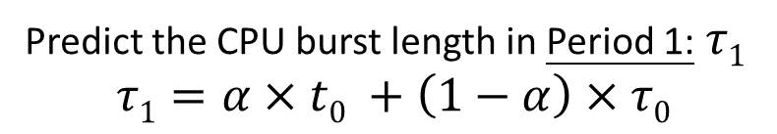




Example
Assume$α=0.8$, $τ0=0.01$
Period 0
Period 1
Period 2
Period 3
T
Predictive :
$$0.01$$
$$0.042$$
$τ$_{n}
Actual :
$$0.05$$
t_{n}
If actual CPU burst length in Period 0 $t_{0}$ = 0.05
Predict the CPU burst length in Period 1:$τ1$
$$τ1=α×t0 +\left(1−α\right)×τ0$$
$$α=0.8$$
$$τ0=0.01$$
$$=0.8×0.05+0.2×0.01=0.042$$
Notes:
我們將每100個c to dirty page做為一個區間
使用exponatio avg指數移動平均來預測下一區間的clean to dirty 的平均發生時間
那這個方法就是對於月靠近現在的值加權較多
舉例來說就是第一個區間的c to dirty平均發生間隔為t1
第二個是t2第三個是t3
而那麼我們預測第四個區間的c->d間隔是t3加權0.8，t2加權0.16，t1加權0.032,
離現在時間越遠的加權越少，這樣來平均，結果就會作為我們預測的t4
假設在這個時間點發生了定量flush,
我們預測下次定量flush的時間點為現在加上1024乘上t4

Slide 54





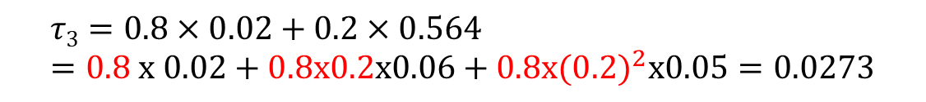


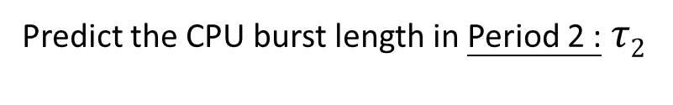




Example (Cont.)
Assume$α=0.8$, $τ0=0.01$
Period 0
Period 1
Period 2
Period 3
T
Predictive :
$$0.01$$
$$0.042$$
$$0.0564$$
$$0.0273$$
$τ$_{n}
Actual :
$$0.05$$
$$0.06$$
t_{n}
$$0.02$$
If actual CPU burst length in Period 1 $t_{1}$ = 0.06
Predict the CPU burst length in Period 2 :$τ2$
$$τ2=α×t1+\left(1−α\right)×τ1$$
$$=0.8×0.06+0.2×0.042=0.0564$$
If actual CPU burst length in Period 1 $t_{1}$ = 0.02
$$τ3=0.8×0.02+0.2×0.564=0.8 x 0.02+0.8x0.2x0.06+0.8x({0.2)}^{2}x0.05=0.0273$$
Notes:
我們將每100個c to dirty page做為一個區間
使用exponatio avg指數移動平均來預測下一區間的clean to dirty 的平均發生時間
那這個方法就是對於月靠近現在的值加權較多
舉例來說就是第一個區間的c to dirty平均發生間隔為t1
第二個是t2第三個是t3
而那麼我們預測第四個區間的c->d間隔是t3加權0.8，t2加權0.16，t1加權0.032,
離現在時間越遠的加權越少，這樣來平均，結果就會作為我們預測的t4
假設在這個時間點發生了定量flush,
我們預測下次定量flush的時間點為現在加上1024乘上t4

Slide 55
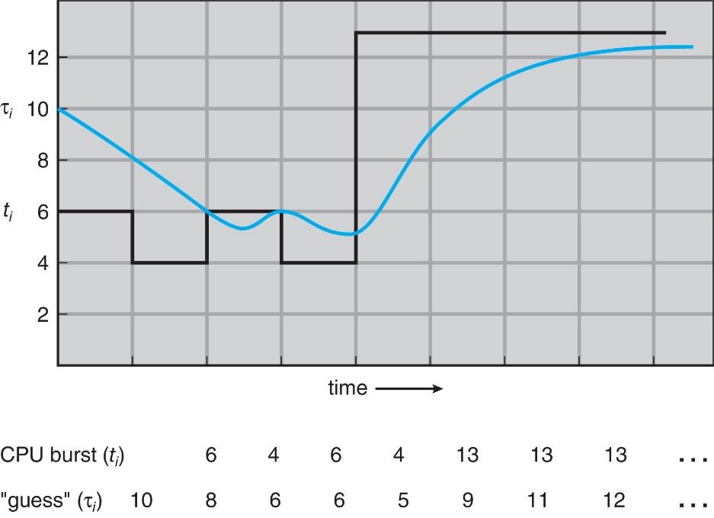
Prediction of the Length of the Next CPU Burst
τ₀ = 10
τ₁₌ α x 6 + (1- α) x 10 = 3 + 5 = 8
τ₂= α x 4+ (1- α) x 8 = 2 + 4 = 6
……

Slide 56
Examples of Exponential Averaging
α =0
τ_{n+1} = τ_{n}
Recent history does not count
α =1
τ_{n+1} = α t_{n}
Only the actual last CPU burst counts
If we expand the formula, we get:
τ_{n+1} = α t_{n}+(1 - α)α t_{n} ₋₁ + … +(1 - α )^{j} α t_{n} _{-j} + …+(1 - α )^{n +1} τ₀
Since both α and (1 - α) are less than or equal to 1,
Each successive term has less weight than its predecessor

Slide 57
Outline
Basic Concepts
Scheduling Criteria
Scheduling Algorithms
First-Come, First-Served Scheduling
Shortest-Job-First Scheduling
Round-Robin Scheduling
Priority Scheduling
Multilevel Queue Scheduling
Multilevel Feedback-Queue Scheduling
Contention Scope in Thread Scheduling
Multiple-Processor Scheduling

Slide 58
Round Robin (RR)
Each process gets a small unit of CPU time
Called time quantum or time slice
Usually 10-100 milliseconds.
After this time has elapsed, the process is preempted and added to the tail of the ready queue
RR 只能是preemptive. Why?
比較: FCFS 只能是non-preemptive. Why?

Slide 59
Round Robin (RR)
Question:
How the OS knows a time quantum is expired?
Sol.:
Timer is set to the time slice value

Slide 60
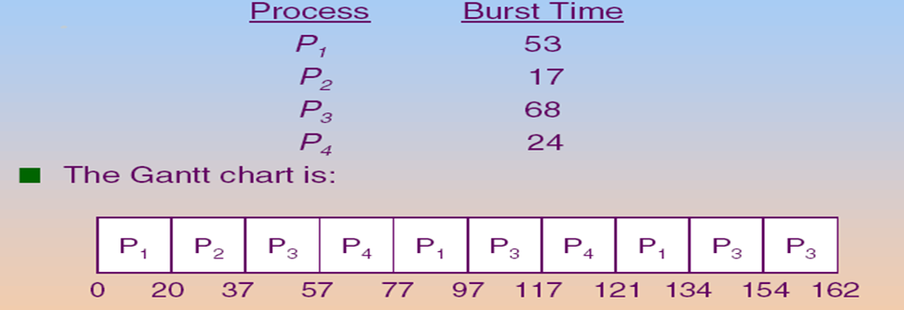
Example: RR with Time Quantum = 20

Slide 61
Round Robin (RR) (Cont.)
If there are n processes and the time quantum is q,
Each process gets 1/n of the CPU time in chunks of at most q time units at once.
No process waits more than (n-1)q time units.
Q: 為什麼是”at most q time unit at once”?

Slide 62
Round Robin (RR) (Cont.)
Typically, RR has higher average turnaround time than SJF, but better response time
Q1: why RR has higher average turnaround time than SJF?
Ans: RR會增加context switch次數, 而context switch需要時間
Q2: why RR has better response time than SJF?
Ans: 等一下就會輪到執行了☺, 而SJF方法, 如果是big task, 可能需要等很久很久

Slide 63
Round Robin (RR) (Cont.)
Performance
q large ⇒ FCFS
q small ⇒ q must be large enough so as to reduce the context switch overhead (see the following slide)
Rule of thumb: 80% of CPU bursts should be shorter than the time quantum (see the following slide)

Slide 64
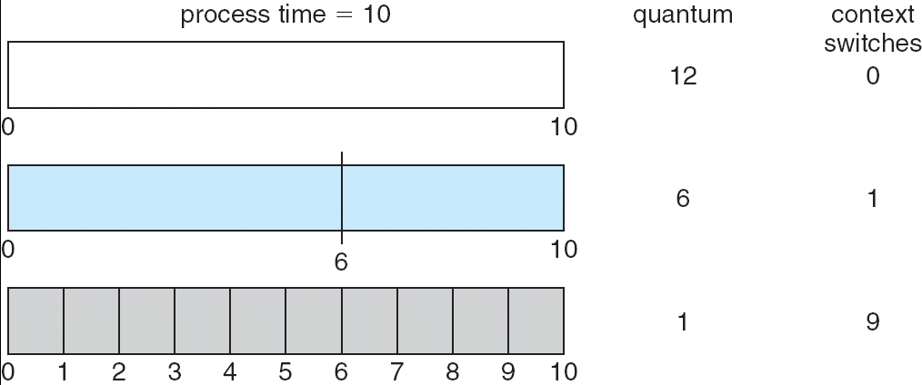


How a Smaller Time Quantum Increases Context Switches
1
Smaller time quantum, larger number of context switches
And context switches are not free!!!

Slide 65
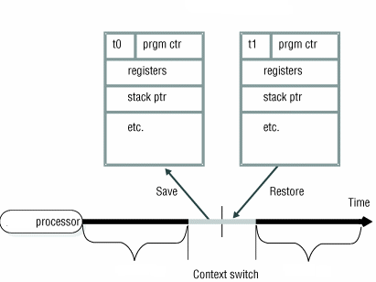
複習：Context Switch
P0’s PCB
P1’s PCB
process P0
process P1

Slide 66
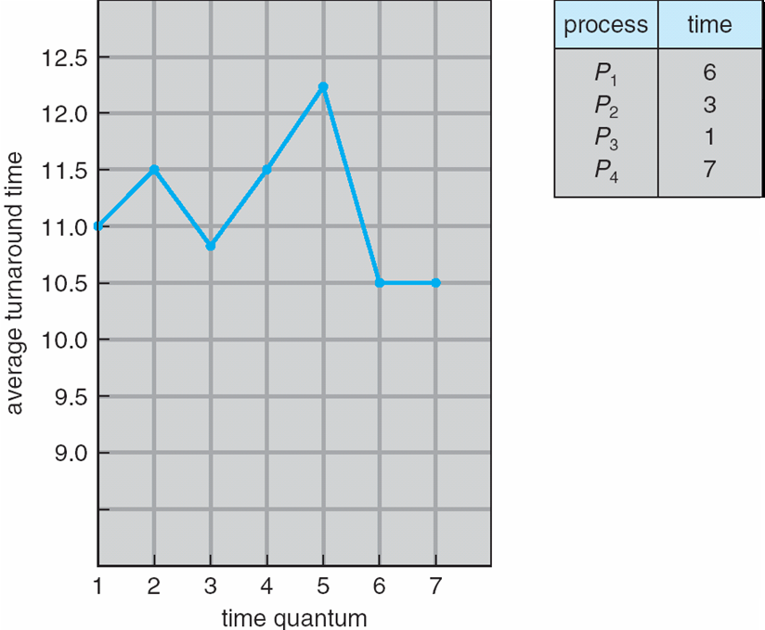
Turnaround Time Varies With The Time Quantum
CPU Burst Time
80% of CPU bursts should be shorter than q
q = 0.5 ⇨ 0%
q = 2 ⇨ 1/4=25%
q = 4 ⇨ 2/4=50%
q = 6 ⇨ 3/4=75%
…
Given four processes: p₁=6, p₂=3, p₃=1, p₄=7
=>The average turnaround time under different value of time quantum

Slide 67
Outline
Basic Concepts
Scheduling Criteria
Scheduling Algorithms
First-Come, First-Served Scheduling
Shortest-Job-First Scheduling
Round-Robin Scheduling
Priority Scheduling
Multilevel Queue Scheduling
Multilevel Feedback-Queue Scheduling
Contention Scope in Thread Scheduling
Multiple-Processor Scheduling

Slide 68
Priority Scheduling
A priority number (integer, say 5, ) is associated with each process
The CPU is allocated to the process with the highest priority
Preemptive
Non-preemptive
Q: 只看priority做為排程的依據會有什麼問題呢?

Slide 69
Priority Scheduling (Cont.)
Ans: starvation or indefinite blocking
Low priority processes may never execute
At MIT, there was a job submitted in 1967 that had not been run when the system IBM 7094 was shutdown in 1973
怎麼辦呢?
Solution : aging
As time progresses increase the priority of the process

Slide 70
Example of Priority Scheduling
Process | Burst Time | Priority
P1 | 10 | 3
P2 | 1 | 1
P3 | 2 | 4
P4 | 1 | 5
P5 | 5 | 2
P₂
P₅
P₁
P₃
P₄
0
1
6
16
18
19
Assume smallest integer ≡ highest priority Average Waiting Time = 8.2

Slide 71
Outline
Basic Concepts
Scheduling Criteria
Scheduling Algorithms
First-Come, First-Served Scheduling
Shortest-Job-First Scheduling
Priority Scheduling
Round-Robin Scheduling
Multilevel Queue Scheduling
Multilevel Feedback-Queue Scheduling
Contention Scope in Thread Scheduling
Multiple-Processor Scheduling

Slide 72
Multilevel Queue Scheduling
Question: if two or more processes have the same priority?
Sol.: combine RR with priority scheduling
Run the process with the highest priority.
Processes with the same priority use round-robin
See the following slide

Slide 73
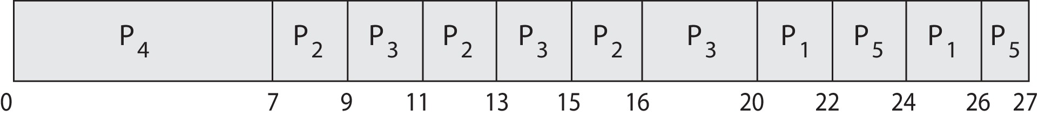
Priority Scheduling with Round-Robin
ProcessA arri Burst TimeT Priority
P₁ 4 3
P₂ 5 2
P₃ 8 2
P₄ 7 1
P₅ 3 3
Gantt Chart wit 2 ms time quantum

Slide 74
Question: 該使用什麼資料結構(How about the data structure)?
Hint: If a single queue is used, O(n) search is necessary each time

Slide 75
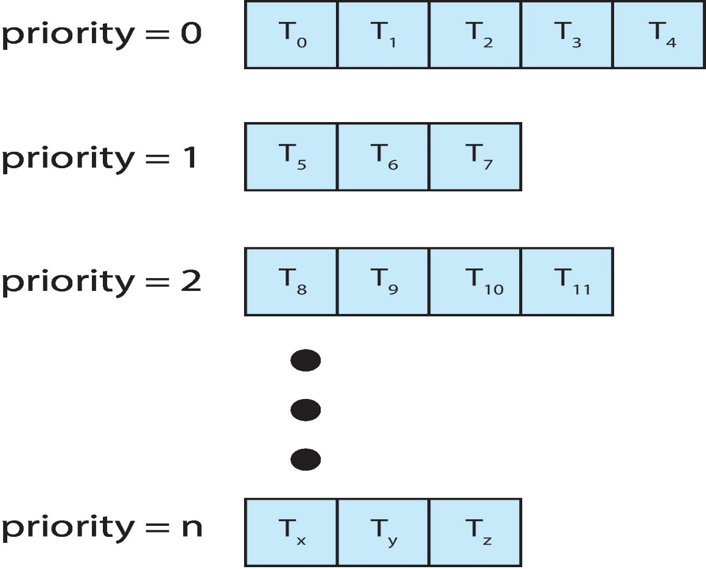
Multilevel Queue Scheduling (Cont.)
Sol.: Multilevel queue is used instead

Slide 76
Multilevel Queue Scheduling
Multilevel queue scheduling can also be used when processes are classified into different types
E.g., foreground (interactive) and background (batch)
higher priority
foreground (interactive): RR
background (batch): FCFS
Example: A Two-Level Queue Scheduling

Slide 77
In this example, why RR is used for foreground processes and FCFS is used for background processes?

Slide 78
Multilevel Queue Scheduling
Ready queue is partitioned into separate queues:
According to process properties and scheduling needs
Each queue has its own scheduling algorithm
Question: scheduling must be done between the queues. 怎麼辦呢?

Slide 79
Multilevel Queue Scheduling (Cont.)
Sol. 1: fixed priority preemptive scheduling:
Foreground queue have absolute priority over background queue
Only when foreground queue is empty, then background queue is executed
Starvation problem
Sol. 2: time-slice based
Each queue gets a certain amount of CPU time
Example:
80% to foreground for RR; 20% to background for FCFS

Slide 80
Outline
Basic Concepts
Scheduling Criteria
Scheduling Algorithms
First-Come, First-Served Scheduling
Shortest-Job-First Scheduling
Priority Scheduling
Round-Robin Scheduling
Multilevel Queue Scheduling
Multilevel Feedback-Queue Scheduling
Contention Scope in Thread Scheduling
Multiple-Processor Scheduling

Slide 81
Multilevel Feedback Queue
A process can move between the various queues
Example: separate processes according to the characteristics of CPU bursts
See the following slide

Slide 82
Example of Multilevel Feedback Queue
Three queues:
Q₀ – RR with time quantum 8 milliseconds
Q₁ – RR time quantum 16 milliseconds
Q₂ – FCFS
Scheduling
A new job enters queue Q₀ which is served RR.
When it gains CPU, job receives 8 milliseconds.
If it does not finish in 8 milliseconds, job is moved to tail of queue Q₁.
If Q₀ is empty, Q₁ is served by RR and receives 16 additional milliseconds.
If it still does not complete, it is preempted and moved to queue Q₂.

Slide 83
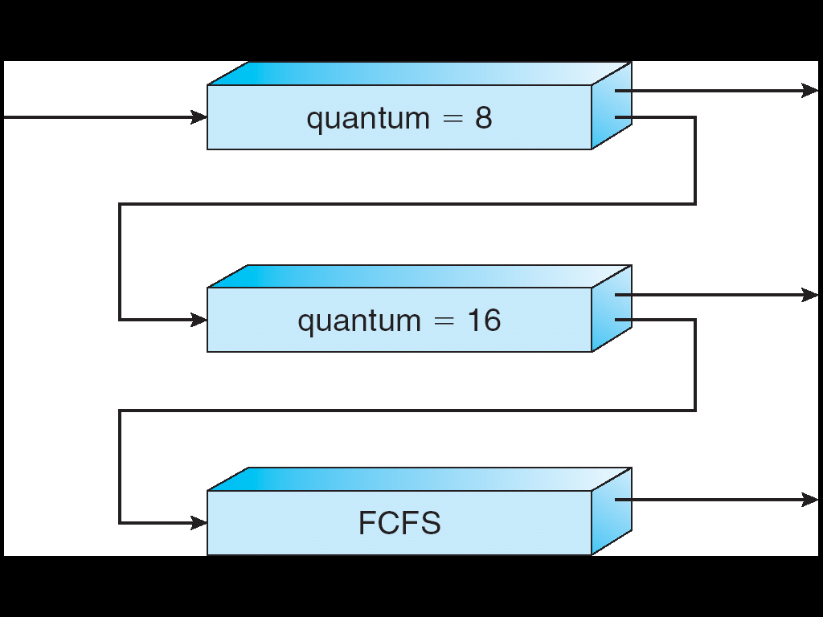
Multilevel Feedback Queues
Give highest priority to processes with CPU burst <= 8ms

Slide 84
Multilevel Feedback Queue
From above example:
A process uses too much CPU time ⇨ move to a lower priority queue.
Leave I/O-bound and interactive processes in the higher priority queues.
I/O-bound and interactive processes has short CPU burst times
Wait too long in a low priority Q ⇨ move to a higher priority queue
Aging

Slide 85
Q1: 為什麼CPU burst time長的process要放在lower priority queue? Q2:為什麼I/O-bound和interactive processes要放在 higher priority queues.

Slide 86
Outline
Basic Concepts
Scheduling Criteria
Scheduling Algorithms
Contention Scope in Thread Scheduling
Multiple-Processor Scheduling

Slide 87
Contention Scope
User threads are managed and scheduled by thread library
Kernel threads are managed and scheduled by OS
所以, 一個user thread要被CPU執行可能需要經過兩層的競爭
第一層: 可能必須跟同一個process內部的其他thread競爭
For M:1 or M:M models
第二層: 可能必須跟系統所有的kernel thread競爭
For all models (1:1, M:1 or M:M)

Slide 88
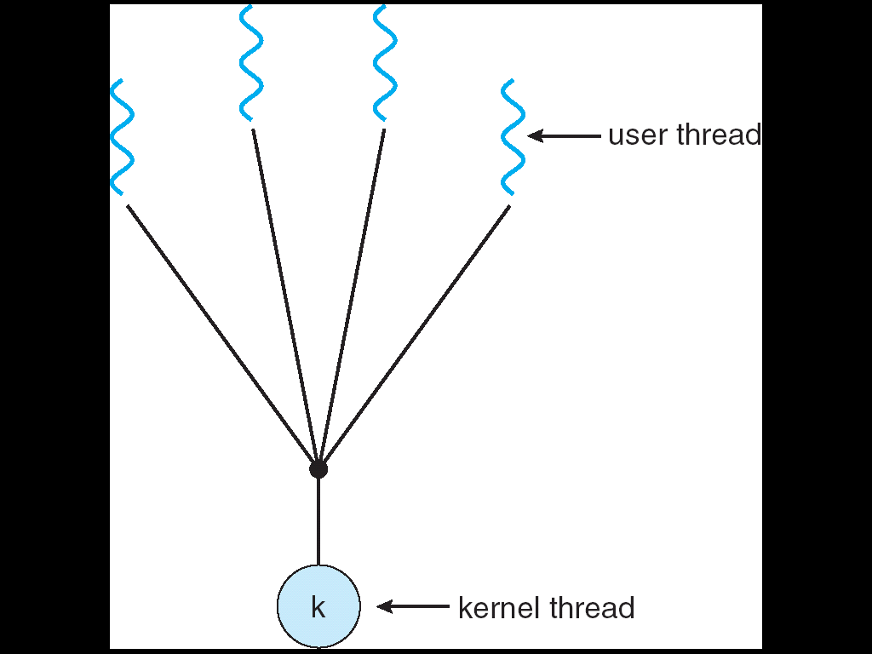
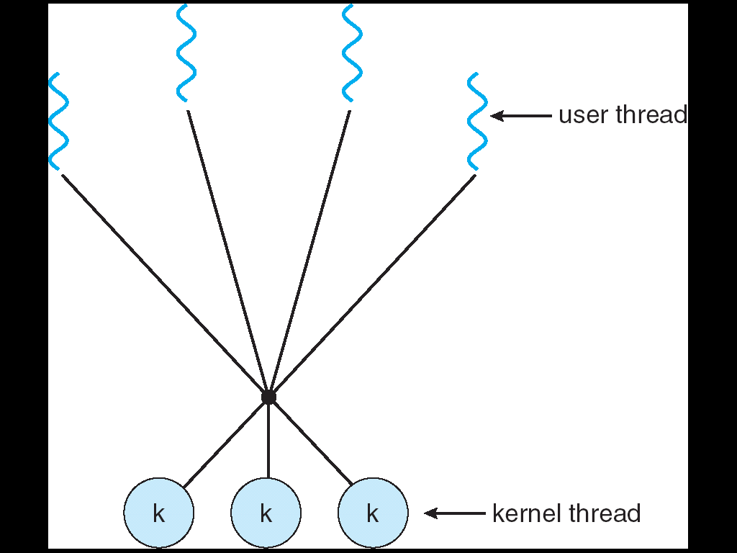
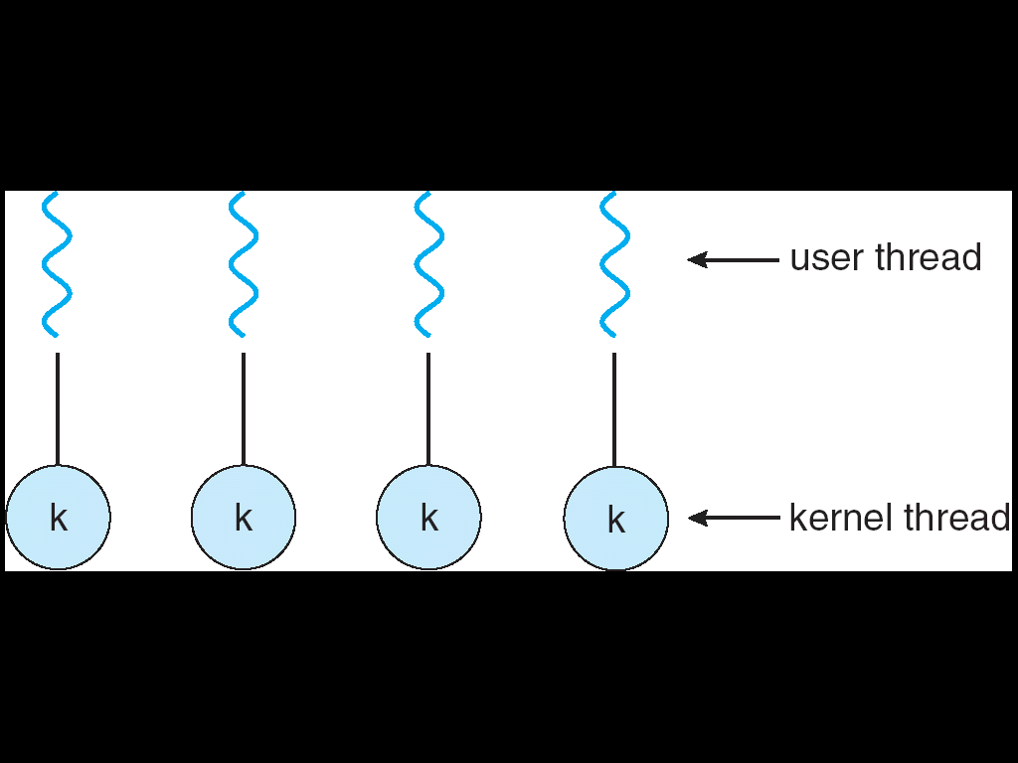
複習：Thread Models

Slide 89
Contention Scope
Process-contention scope (PCS)
For M:1 or M:M models
Threads library schedules user thread to put onto an available kernel thread
Competitions among threads of the same process
Systems with 1:1 model don not have PCS
System-contention scope (SCS)
Kernel decides which kernel thread to run on a CPU core
Competitions among all kernel threads in the system

Slide 90
Outline
Basic Concepts
Scheduling Criteria
Scheduling Algorithms
Thread Scheduling
Multiple-Processor Scheduling

Slide 91
Multiple-Processor Scheduling
CPU scheduling more complex when multiple CPUs are available
Multi-processor may be any one of the following architectures:
Multicore CPUs
Multithreaded cores
NUMA systems
Heterogeneous multiprocessing
homogeneous

Slide 92
Outline
Basic Concepts
Scheduling Criteria
Scheduling Algorithms
Thread Scheduling
Multiple-Processor Scheduling
Multicore Processors
Approaches to Multiple-Processor Scheduling
Load Balancing
Processor Affinity
Heterogeneous Multiprocessing

Slide 93
Multicore Processors
Multicore processor: multiple processor cores on the same chip
Problem: memory stall (使動彈不得)
CPU cores waits for data to become available (see the following slide)
怎麼辦呢?
Sol. 1: 就等吧~ (很久以前的做法)
有其他的方法嗎?

Slide 94
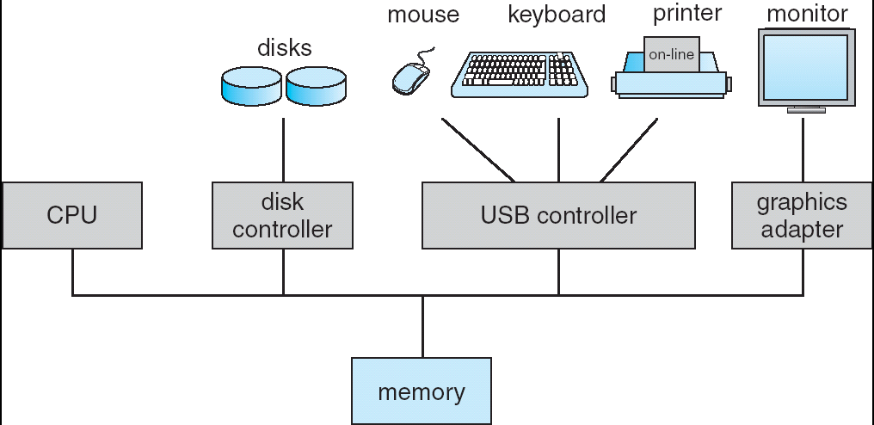
A Computer System
CPU registers

Slide 95
Memory Stall when Accessing Temp Variable
…
mov eax, 10
mov temp, eax
…
CPU
…..
temp
eax | 10
OS

Slide 96
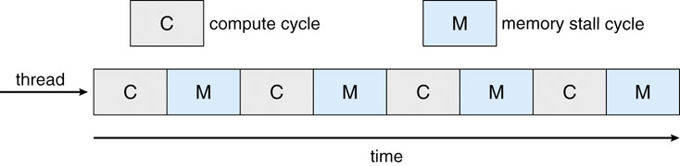
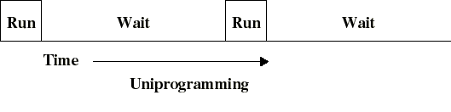
Multicore Processors
複習: 事實上, 我們在第一章學過類似的問題~
Uni-programming: OS等待I/O存取的完成 (I/O stall)
Memory stall: CPU等待記憶體存取的完成

Slide 97
之前怎麼解的呢?

Slide 98
複習: Multi-Programming
OS performs context Switch

Slide 99
Multicore Processors (Cont.)
之前的做法是OS切換process執行(context switch)
是不是可以使用類似的作法呢?
Q1: 誰負責context switch? CPU or OS?
Q2: context switch必須觸發state save/state restore, 如何處理呢?

Slide 100
Multicore Processors (Cont.)
Q1: 誰負責context switch? CPU
Why not OS?
是CPU等待記憶體存取的完成
只有CPU知道發生memory stall, OS不知道 (see the following slide)

Slide 101
OS不知道發生Memory Stall
…
mov eax, 10
mov temp, eax
…
CPU
…..
temp
eax | 10
OS

Slide 102
Multicore Processors (Cont.)
Q2: context switch必須觸發state save/state restore, 如何處理呢?
之前如何處理呢?
將暫存器的值儲存到記憶體(PCB或是TCB)
See the following slide

Slide 103
Context Switch
…
out eax, 0x60;
add eax, ebx;
…
CPU
context
switch
eax | 59
ebx | 25
eax | 10
ebx | 5
…
out eax, 0x30;
add ebx, ebx;
…
…..
P1 PCB
eax=10; ebx=5;……
P1 PCB
eax=x; ebx=y;……
OS
P2 PCB
eax=59; ebx=25;……
OS

Slide 104
Multicore Processors (Cont.)
Q: 可以使用相同的做法嗎?
Ans: 不行
Why?
已經memory stall了, 存取PCB/TCB又必須存取記憶體

Slide 105
Q: 怎麼辦呢?
Hint: 你學過的

Slide 106
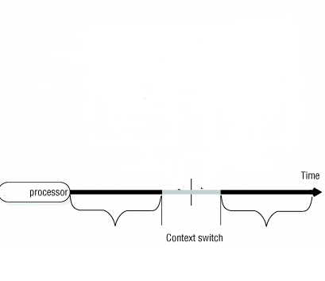
複習：Multiple Sets of Registers
CPU
eax₁=1;
ebx₁=5;
ecx₁=8;
edx₁=6;
……
eax₂=4;
ebx₂=3;
ecx₂=7;
edx₂=8;
……
……
process P1
process P2

Slide 107
CPU Core Performs Context Switch
…
out eax, 0x60;
add temp, eax;
…
memory stall
CPU Core
…
out eax, 0x30;
add ebx, ebx;
…
…..
eax | 59
ebx | 45
eax | 10
ebx | 5
context
switch
P1 PCB
eax=x; ebx=y;……
OS
P2 PCB
eax=59; ebx=25;……
OS

Slide 108
上面提到的技術稱為Chip-multithreading (CMT).
以上圖為例, CPU core內部有兩個threads (called hardware threads)
Thread: 一段程式碼
Hardware thread: 硬體可以認知到此一程式碼的存在並管理(context switch)執行此一段程式碼

Slide 109
整理: Chip-multithreading (CMT)
Problem: memory stall (使動彈不得)
Solution: Chip-multithreading (CMT)
Two or more threads (called hardware threads) in a core
If one hardware thread stalls, the core switches to another hardware thread
Each hardware thread appear as a logical processor to OS
Each hardware thread has its own program counter and register set
Hyper-threading (also known as simultaneously multithreading or SMT) technology on Intel processor

Slide 110
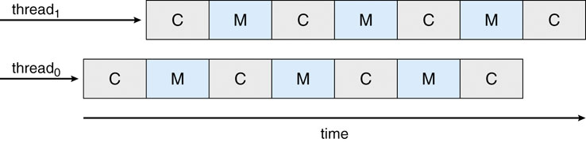
Context Switch is performed by CPU
Multithreaded system: the two hardware threads share the same CPU core
-in fact, only one hardware thread is running at a time

Slide 111
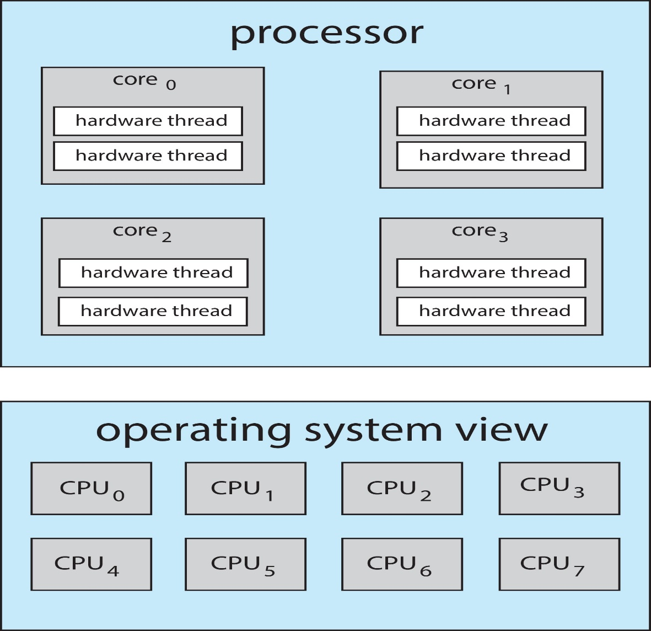
A Dual-Threaded, Quad-Core System
Thus, a dual-threaded, quad-core system ⇨ eight logical processor to the OS

Slide 112
If M-to-M or M-to-1 Model
Three levels of scheduling
Level 1: choose which user thread to run on each kernel thread
Done by thread library
Level 2: choose which kernel thread to run on each logical processor
Done by the OS
Level 3: choose which hardware thread to run on a CPU core
Done by the hardware

Slide 113
If One-to-One Model
Two levels of scheduling
Level 1: choose which kernel thread to run on each logical processor
Done by the OS
Level 2: choose which hardware thread to run on a CPU core
Done by the hardware

Slide 114
Outline
Basic Concepts
Scheduling Criteria
Scheduling Algorithms
Thread Scheduling
Multiple-Processor Scheduling
Multicore Processors
Approaches to Multiple-Processor Scheduling
Load Balancing
Processor Affinity
Heterogeneous Multiprocessing

Slide 115
Q: 假設有4顆CPU cores, 現在有一個process P1要被執行, P1要被執行在哪一個核心呢?誰來決定呢?

Slide 116
Approaches to Multiple-Processor Scheduling
Asymmetric multiprocessing
Only the master processor handle the scheduling algorithm (see the next slide)
Advantage: simple
Disadvantage: master becomes the bottleneck
Symmetric Multiprocessing (SMP)
Each processor makes its own scheduling decisions (see the following slide)
Standard approach, adopted by Windows, Linux, Mac OS
We focus on SMP systems

Slide 117
Asymmetric Multiprocessing
Scheduling algorithm

Slide 118
Asymmetric Multiprocessing
Scheduling algorithm

Slide 119
Symmetric Multiprocessing
Scheduling algorithm
Scheduling algorithm
Scheduling algorithm
Scheduling algorithm

Slide 120
Q: 那ready queue的架構呢?

Slide 121
Approaches to Multiple-Processor Scheduling (Cont.)
Organizations of the ready queue in SMP
A common ready queue, or
Need to protect the queue (addressed later)
Accessing the queue is a performance bottleneck
Each processor has its private ready queue
Good
Does not have the protection problem
Allow more efficient use of cache memory (addressed later)
Bad
Workload of varying size ⇨ solved by load balance (addressed later)
Most commonly used

Slide 122
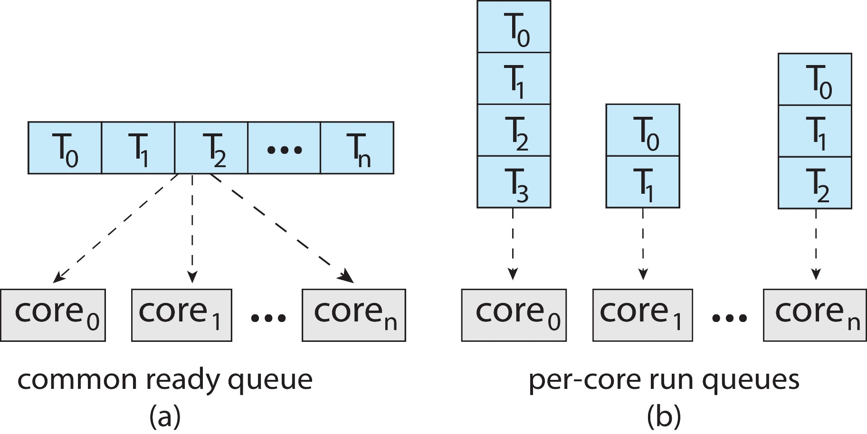
Organizations of Ready Queue in SMP

Slide 123
Outline
Basic Concepts
Scheduling Criteria
Scheduling Algorithms
Thread Scheduling
Multiple-Processor Scheduling
Multicore Processors
Approaches to Multiple-Processor Scheduling
Load Balancing
Processor Affinity
Heterogeneous Multiprocessing

Slide 124
Q: 如果每一個核心有自己的ready queue, 會有負荷不平均的問題. Why?
Hint: see the following slide

Slide 125
複習：Organizations of Ready Queue in SMP

Slide 126
Load Balancing
If each processor has its private ready queue
Must keep the workload evenly distributed across all processors
也就是必須實現load balance

Slide 127
Q: 如何實現Load balancing?
Hint:成長是一次又一次離開,
離開熟悉的街巷，去尋找更大的天空(余光中, 鄉愁)
Ans: by process migration

Slide 128
Q: 如果是common ready queue, 也會有負荷不平均的問題嗎?
Ans: 不會, in common-ready-Q systems, the load is already balanced

Slide 129
Outline
Basic Concepts
Scheduling Criteria
Scheduling Algorithms
Thread Scheduling
Multiple-Processor Scheduling
Multicore Processors
Approaches to Multiple-Processor Scheduling
Load Balancing
Processor Affinity
Heterogeneous Multiprocessing

Slide 130
可是, 有時候我們喜歡待在故土 (李白:低頭思故鄉; 杜甫: 月是故鄉明)
Process亦是如此, Why?
Hint: process的故土是什麼呢?

Slide 131
Processor Affinity (喜好）
Most multi-processor systems avoid process migration. Why?
Ans.: when a process migrates to another processor
Old cache memory must be invalidated
New cache memory must be re-populated
See the following slide

Slide 132
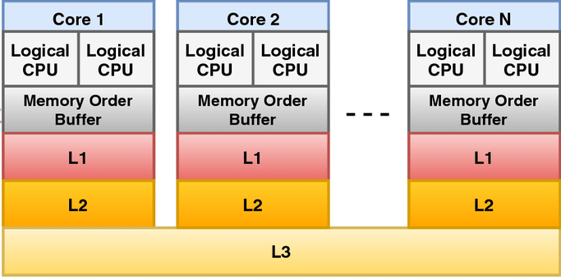
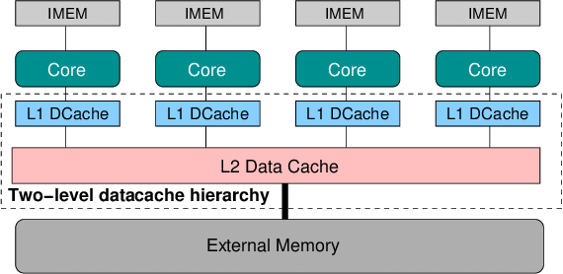
https://www.researchgate.net/figure/Cache-hierarchy-of-an-Intel-processor-the-L3-cache-is-shared-among-available-cores_fig3_321241798

Slide 133
Processor Affinity (喜好）
Processor affinity: keep a process/thread running on the same processor
Q1:如果是per-processor ready queues, 如何提供processor affinity
Ans.: processor affinity is provided for free (see the next slide)
Q2:如果是採用a common ready queue, 如何提供processor affinity
Ans.: need special handling. (see the next slide)

Slide 134
複習：Organizations of Ready Queue in SMP

Slide 135
Processor Affinity (喜好）(Cont.)
But, loading balancing counteracts processor affinity
Load balancing is done by process migration
Processor affinity try not to migrate processes
需要衡量

Slide 136
Outline
Basic Concepts
Scheduling Criteria
Scheduling Algorithms
Thread Scheduling
Multiple-Processor Scheduling
Multicore Processors
Approaches to Multiple-Processor Scheduling
Load Balancing
Processor Affinity
Heterogeneous Multiprocessing

Slide 137
Heterogeneous Multiprocessing
The above four issues assume homogeneous multi-processors
Heterogeneous Multiprocessing (HMP)
Cores that run the same instruction set, yet vary their clock speed and power management
Example: ARM big.L ITTLE architecture
High performance big cores and energy efficient LITTLE cores

Slide 138
Q: CPU Scheduler如何利用ARM big.LITTLE architecture?

Slide 139
Heterogeneous Multiprocessing (Cont.)
Ans.:
Assign background tasks (例如: 定位服務,資料同步) to little cores,
Assign interactive tasks to big cores

